Slide 1
Taming WOLF: Building a More Functional and User-Friendly Framework
Casey Sader
University of Kansas, EECS

Slide 2
outline
Introduction
Objective and Motivation
Background and Related Tools
Contributions
Demonstration
Future Work
Conclusion

Slide 3
Introduction
WOLF created by Pranav Bahl in 2016
Select the best hyper-parameters for a model
Goal is to make WOLF more functional and user-friendly
Novice user is the target audience

Slide 4
objective
Improve the functionality of the existing framework
Create a more user-friendly framework
Website
Modern technology – neural network
Save trained models
Make predictions
Feature importance
Datasets

Slide 5
Motivation
Automate tasks in the machine learning pipeline
WOLF missing key tasks in the pipeline
Make WOLF more accessible
TensorFlow
Provide a trained model to the user
Make predictions within the framework
Understanding of datasets and feature importance
Provide benchmark datasets

Slide 6
Wolf background
Allows a user to control each step of the machine learning pipeline
Each task is called a “transaction”
Control the pipeline with a configuration file (yaml file)
Select dataset, transactions, and how to run each transaction
Models implemented using Scikit-Learn
Possible transactions are pre-processing, data splitting, feature extraction, feature selection, model construction, metric evaluation, and model selection

Slide 7
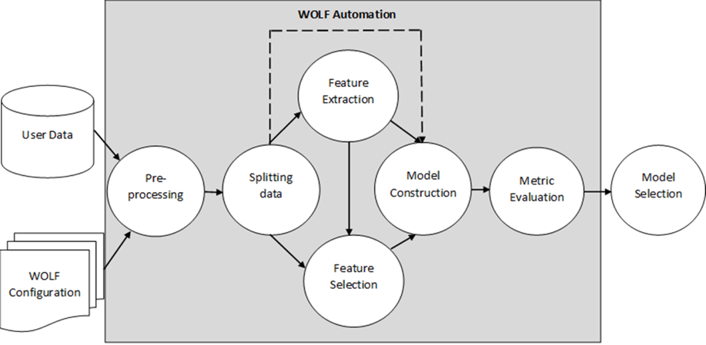
WOLF Background

Slide 8
WOLF Background
Pre-processing
﻿Performs any step needed to make the dataset complete for WOLF

Slide 9
WOLF Background
Pre-processing
Splitting Data
﻿Splits the data into train and test files

Slide 10
WOLF Background
Pre-processing
Splitting Data
Feature Extraction
﻿Perform dimensionality reduction

Slide 11
WOLF Background
Pre-processing
Splitting Data
Feature Extraction
Feature Selection
﻿Selects features that are noisy or redundant and removes them

Slide 12
WOLF Background
Pre-processing
Splitting Data
Feature Extraction
Feature Selection
Model Construction
﻿For each machine learning model type and each combination of hyper-parameters that are to be tested on, a model is trained on every train/test set combination

Slide 13
WOLF Background
Pre-processing
Splitting Data
Feature Extraction
Feature Selection
Model Construction
Metric Evaluation
﻿Accuracy, precision, ROC-AUC, MCC, and F1-Score

Slide 14
WOLF Background
Pre-processing
Splitting Data
Feature Extraction
Feature Selection
Model Construction
Metric Evaluation
Model Selection
﻿Determines the best model and hyper-parameter combination

Slide 15
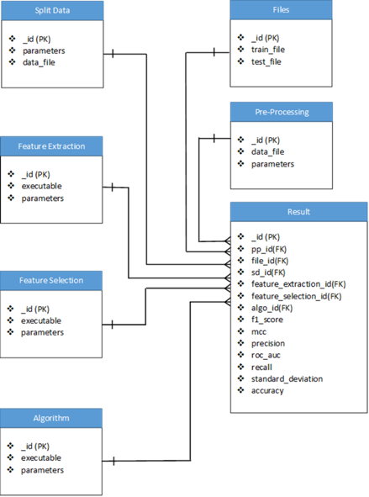
WOLF Background
MongoDB used to store dataflow
Every configuration and parameter is stored along with an id value to keep track of each run

Slide 16
WOLF models
Ada Boost Classifier
Bernoulli Naïve Bayes
Gaussian Naïve Bayes
Decision Tree
Logistic Regression
Random Forest
C-SVM
Linear SVM
Nu SVM
Linear Discriminant Analysis
Quadratic Discriminant Analysis
Neural Network (using Caffe)

Slide 17
Related tools
Auto-WEKA
2013 at the University of British Columbia
Classification using 39 different algorithms
Bayesian-optimization used to search hyper-parameters
Michelangelo
Created by Uber to perform the machine learning workflow from beginning to end
Six steps: “managing data, training models, evaluating models, deploying models, making predictions, and monitoring predictions”
Can run on the massive scale needed for Uber

Slide 18
contributions
Website
Neural network (TensorFlow)
Saved model and predictions
Feature importance
Datasets

Slide 19
Website (Overview)
Allow runs of WOLF for non-ITTC members
Implement all of the features of the command line version
Keep the runs of all users separate
Make WOLF more user-friendly and intuitive
Work compiled for 2017 IEEE International Conference on Big Data

Slide 20
Website (my individual work)
Contributed to planning out the goals and what a user should expect
Decided file structure, a project timeline, and the visual layout
Created and implemented the initial setup of the SQL database
Enabled user to view and run their own workflows

Slide 21
Neural network
Deep learning in WOLF used Caffe when this project began
Caffe no longer the most popular framework for neural networks
Top two are PyTorch and TensorFlow

Slide 22
Neural network
PyTorch
Framework built using Torch
Useful for creating neural networks that are reusable
“Reverse-mode auto-differentiation” allows changes to models with little overhead
TensorFlow
Created by Google to perform computations on CPUs and GPUs (and TPUs)
Takes advantage of the flow graphs of tensors
Can be used for the end-to-end machine learning pipeline
Chosen for its large market share and the value it would have

Slide 23
Neural network
Keras API used for high-level implementation of neural networks
Runs on top of TensorFlow
Keras is the second most popular framework on its own
API function calls similar to Scikit-Learn so the transition in syntax was simpler
Runs on GPU

Slide 24
Neural network

Slide 25
Saved models
WOLF was lacking the ability to return a trained model to the user
WOLF creates a new model for each train/test split pair
Saving the model is performed using pickle
Each model is stored in the designated folder for the hyper-parameters
The full path of the best pickled model is given to the user in the “best configuration” tab of the results excel file
By default, the best model has the highest ROC-AUC score

Slide 26
predictions
Prediction transaction now available in configuration file
The user will provide the dataset to predict on and the model to use
Optional parameters: feature to predict, whether to calculate accuracy or not
The data is read in and put into the proper format for the model
The pickled model is also loaded in
Predictions are written to a file which the user can use

Slide 27
Feature importance
Relative importance each feature has on the prediction outcome of a model
Calculated from the model itself rather than the dataset (as feature extraction and selection attempt to do)
Feature importances are calculated, sorted, and written to a file
The number of files is the same as the number of models
The feature importances of the best model are also in the results excel file

Slide 28
Feature importance
Random forest, decision tree, and ada boost use the built-in attribute feature_importances_ from Scikit-Learn
Most other models use the coefficient matrix from Scikit-Learn
Using Keras, there isn’t an attribute or function to call
Neural networks are not inherently transparent or interpretable
“Leave one out” strategy
ELI5

Slide 29
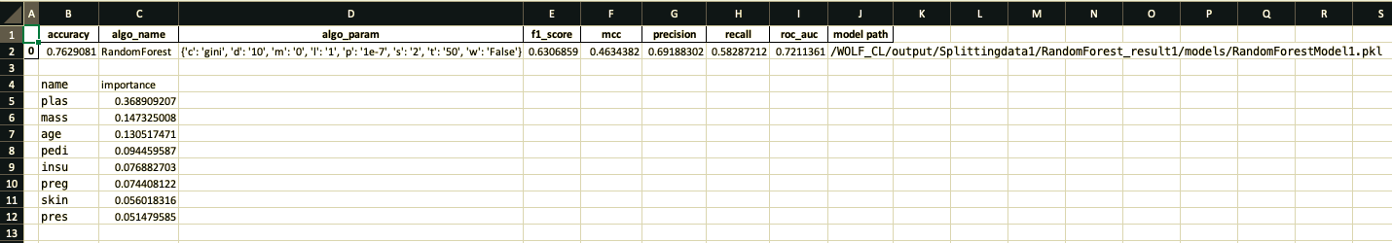
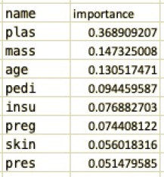

Results file

Slide 30
datasets
Used to test the effectiveness of WOLF
From UCI Machine Learning repository
Downloaded and converted to arff format
Datasets are both binary classification and multi-class classification

Slide 31
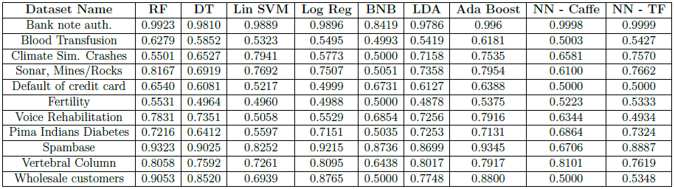
datasets

Slide 32
New architecture

Slide 33
New architecture

Slide 34
Future work
Continued website work (e.g., display results)
Improvements to feature importance addition
Image data
More model types (e.g., regression)
GPU reservation
Command line use off of ITTC cluster
Port to Python 3

Slide 35
Demo

Slide 36
Final thoughts
Learned about writing code that meets industry standards
Important to be able to add to frameworks and tools easily
Project can be a guide for future students to continue improving WOLF

Slide 37
Publications
Sohaib Kiani, Xiaoli Li, Pranav Bahl, Casey Sader, and Jun Huan. WOLF: Machine Learning Workflow Management Framework. 2017.
Xiaoli Li, Sohaib Kiani, Pranav Bahl, Casey Sader, and Jun Huan. WOLF: Machine Learning WOrkfLow Management Framework. Boston, MA, 2017. url: http://cci.drexel.edu/bigdata/bigdata2017/files/Tutorial3.pdf.

Slide 38
Thank You!
Questions?

